Slide 1
MuleSoft Anypoint Platform

Slide 2
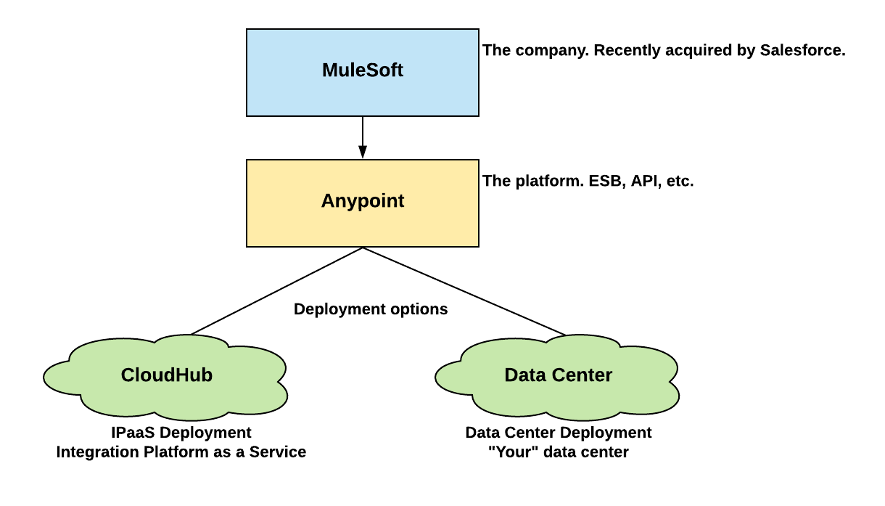
Mulesoft

Slide 3
Anypoint platform
Features of Anypoint platform
Design Center
Exchange
Management Center
Access Management
API Manager
Runtime Manager

Slide 4
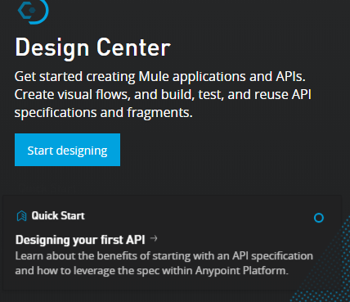
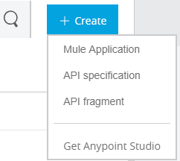
Anypoint platform
Design Center
Mule Application
Hosted environment where we can create Mule apps and test the functionality
API Specification
RAML specification
API fragment
Use/reuse in API spec

Slide 5
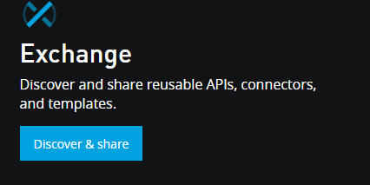
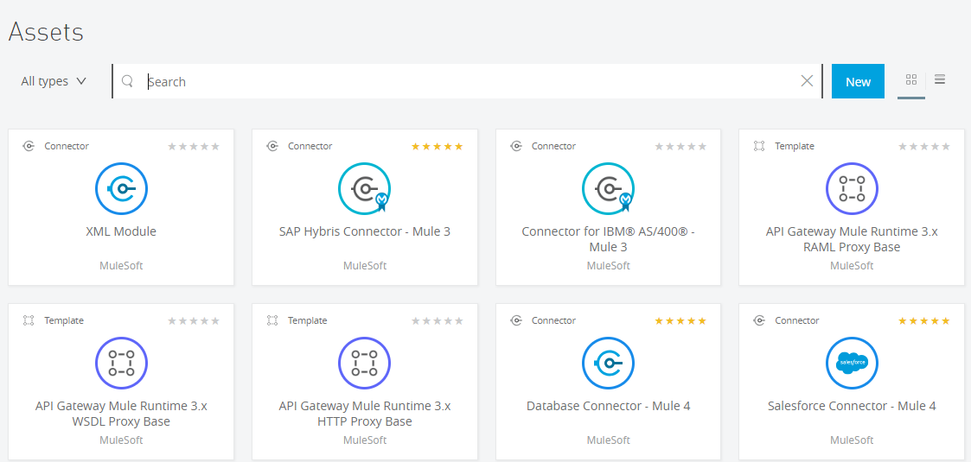
Exchange
Share reusable API’s which can used
across enterprise
Discover API’s shared by other users and request
access to the API.

Slide 6
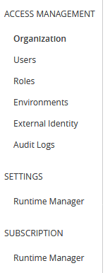
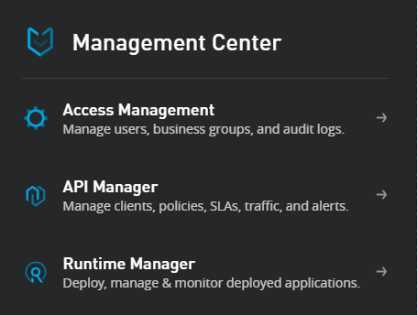
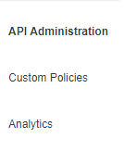
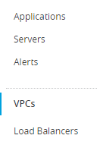
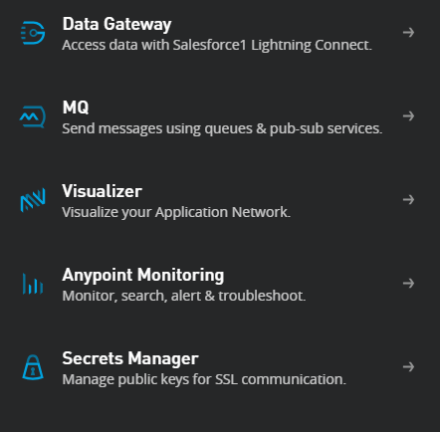
Management Center
API Manager
Runtime Manager

Slide 7
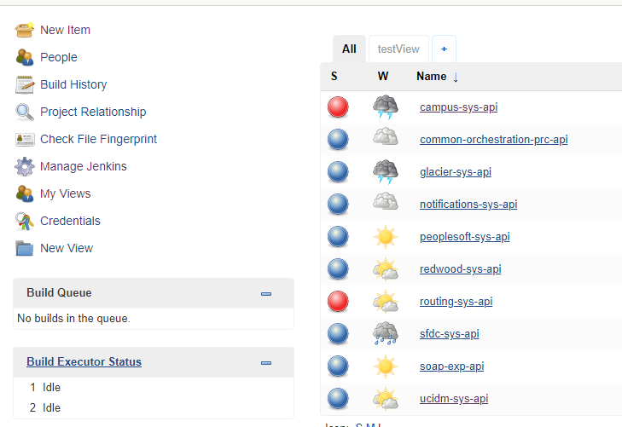
Continuous Integration /Continuous Development
Jenkins is a self-contained, open source automation server which can be used to automate all sorts of tasks related to building, testing, and delivering or deploying software

Slide 8
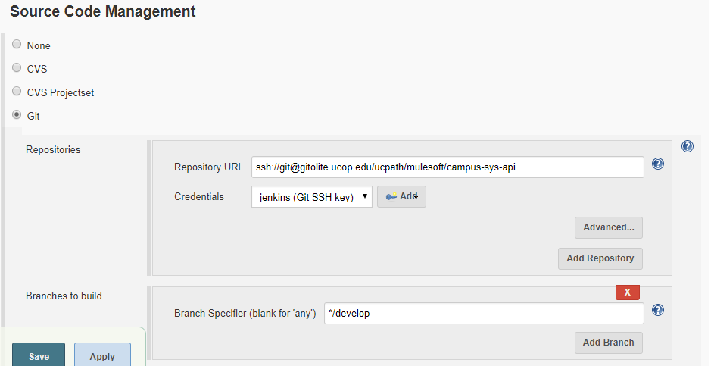
GIT
GIT is the source code repository we are using for mule app’s. Repository URL of GIT and the branch it build’s on

Slide 9
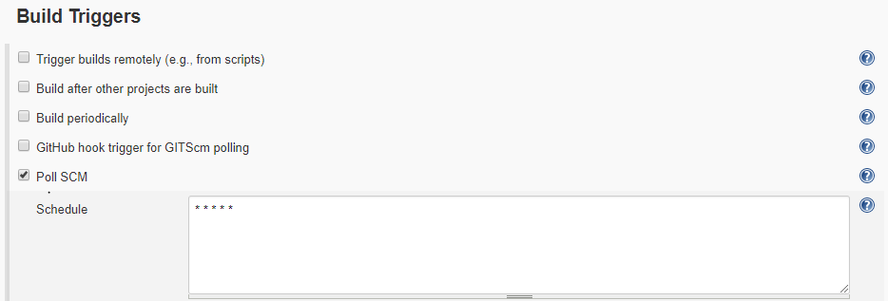
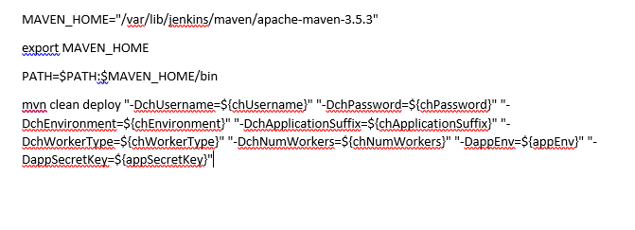
Polling interval
Build script

Slide 10
High-level Architectural Design
Integration Architectural Patterns
API Led Connectivity
Reliability Pattern
High Availability Pattern

Slide 11
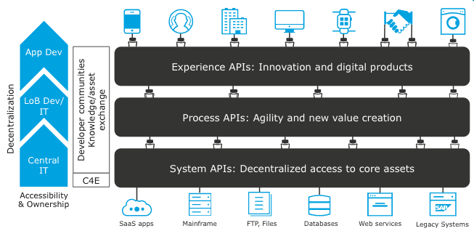
API Led Connectivity
Layers
System APIs
Process APIs
Experience APIs

Slide 12
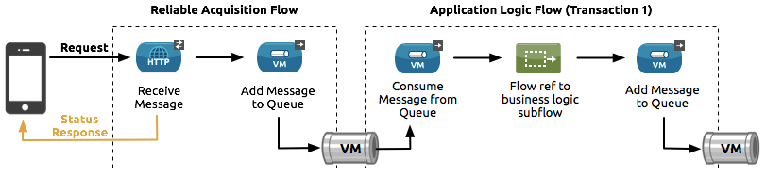
Reliability Pattern
High-level Architectural Design …

Slide 13
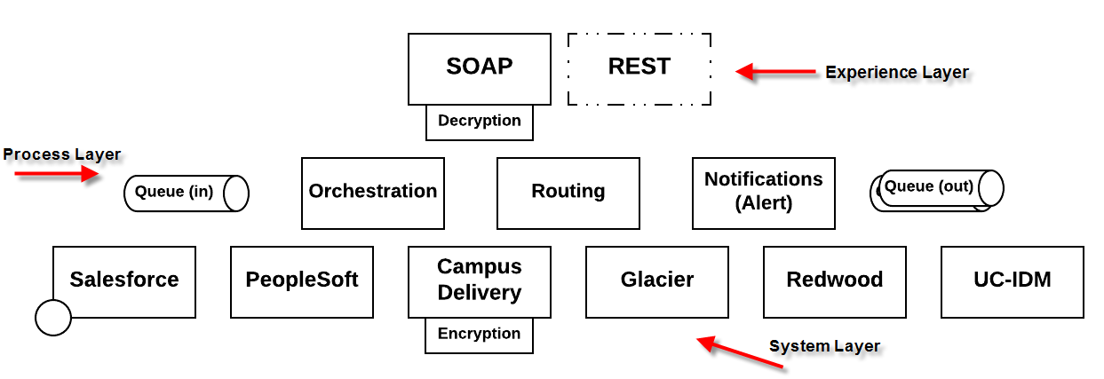
Service Topology
High-level Architectural Design …
Notes:
Accelerate developer productivity with a single graphical environment for integration with SaaS and on-premises systems, data integration, API implementation, and testing. Then deploy your applications on-premises or in the cloud with the Mule runtime.

Slide 14
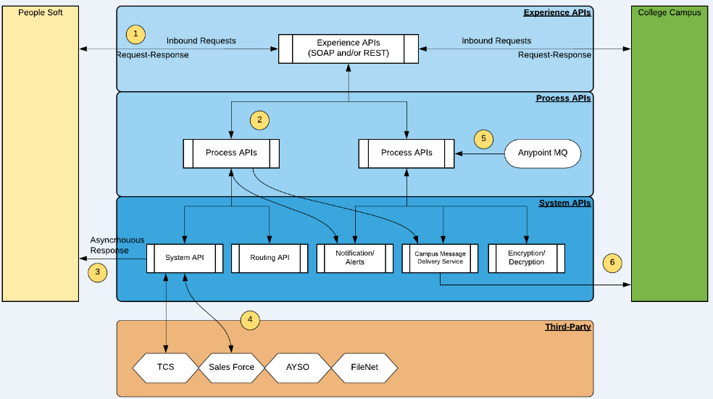
Internal Mule API/Service Architecture
High-level Architectural Design …
Notes:
Accelerate developer productivity with a single graphical environment for integration with SaaS and on-premises systems, data integration, API implementation, and testing. Then deploy your applications on-premises or in the cloud with the Mule runtime.

Slide 15
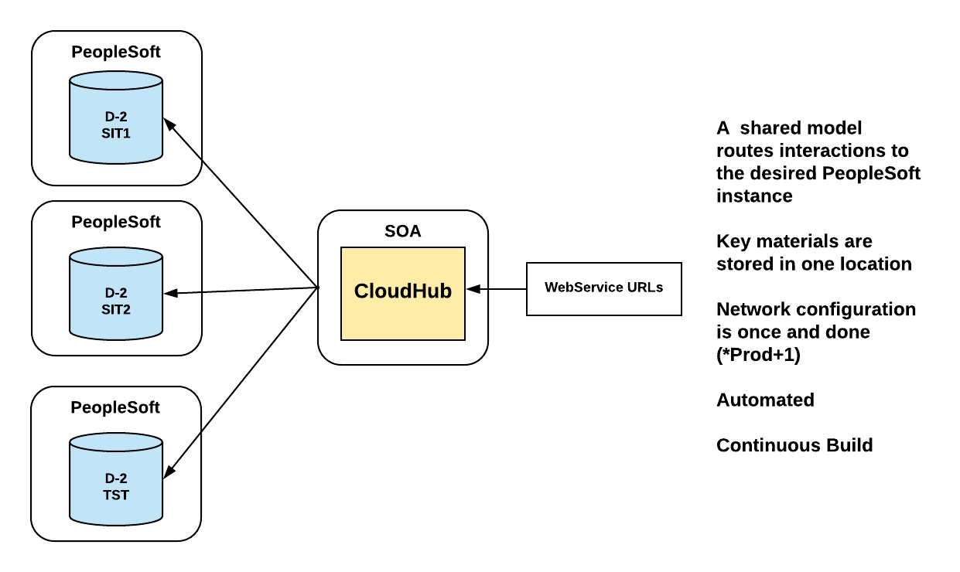
Current Integration Platform…
Few environments, more automation

Slide 16
Anypoint Studio - IDE
Eclipse based IDE, open source & free
Build integrations graphically or in XML
Jumpstart your integrations with pre-built connectors, templates, and examples
Debug with design-time error-handling or Java and XML exception handling
Map and transform data easily - Dataweave
Integrate testing into your existing CI/CD process using MUnit
Easily deploy APIs and integrations built in Studio to the cloud or on-premises
Built-in Maven support
High-level Architectural Design …
Notes:
Accelerate developer productivity with a single graphical environment for integration with SaaS and on-premises systems, data integration, API implementation, and testing. Then deploy your applications on-premises or in the cloud with the Mule runtime.

Slide 17
Mule Application
Flow
Message Source
Message Processors
Connectors
Transformers
Filters
Flow Controls
Scopes
Error Handlers
Sub-flow
Notes:
Accelerate developer productivity with a single graphical environment for integration with SaaS and on-premises systems, data integration, API implementation, and testing. Then deploy your applications on-premises or in the cloud with the Mule runtime.

Slide 18
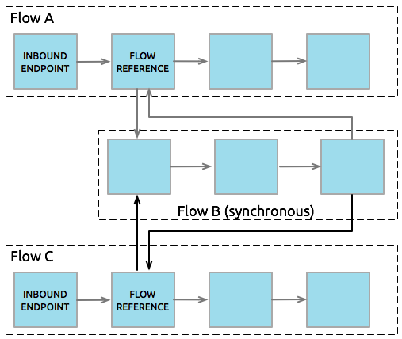
Mule Application …
Notes:
Accelerate developer productivity with a single graphical environment for integration with SaaS and on-premises systems, data integration, API implementation, and testing. Then deploy your applications on-premises or in the cloud with the Mule runtime.

Slide 19
Building a Mule Application
Define API spec in Design Center
Import project into Studio
Generate Flows
Generate Munit
Commit & Deploy
Test
Mule Application …
Notes:
Accelerate developer productivity with a single graphical environment for integration with SaaS and on-premises systems, data integration, API implementation, and testing. Then deploy your applications on-premises or in the cloud with the Mule runtime.

Slide 20
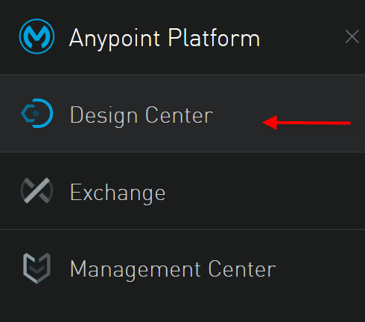
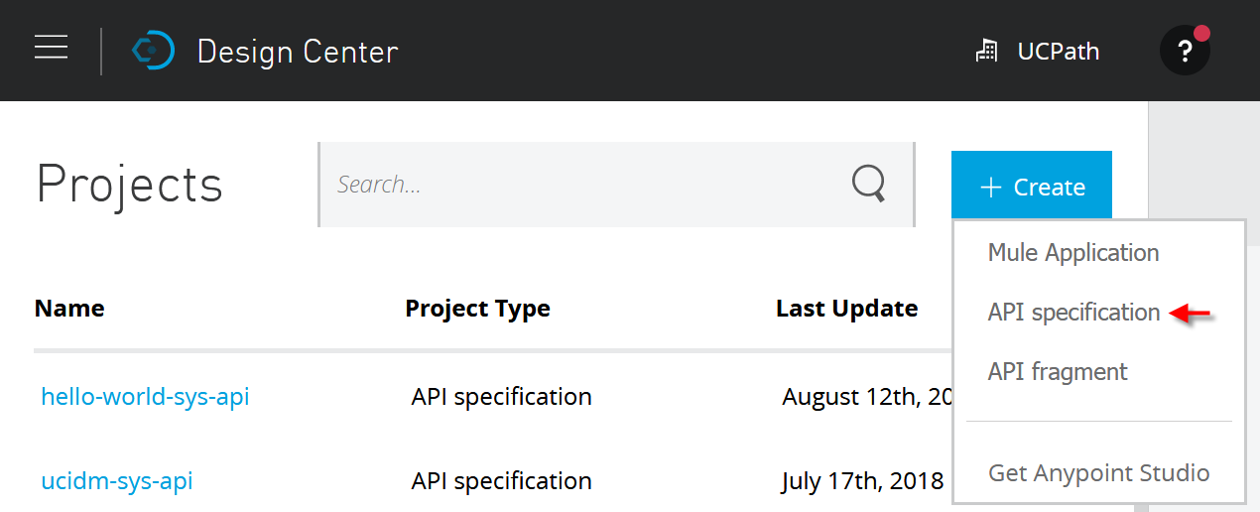
Building a Mule Application
High-level Architectural Design …
Notes:
Accelerate developer productivity with a single graphical environment for integration with SaaS and on-premises systems, data integration, API implementation, and testing. Then deploy your applications on-premises or in the cloud with the Mule runtime.

Slide 21
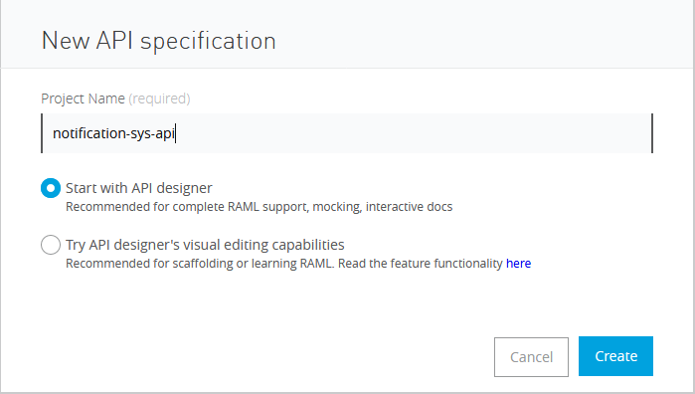
U
C
P
A
T
H
O
N
A
N
Y
P
O
I
N
T
P
L
A
T
F
O
R
M
Mule Application …

Slide 22
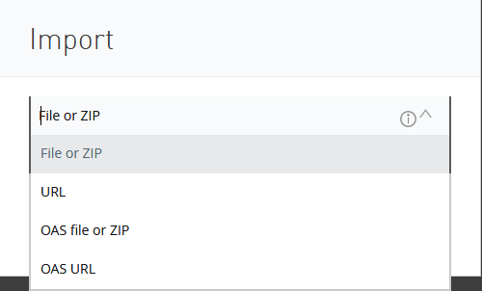
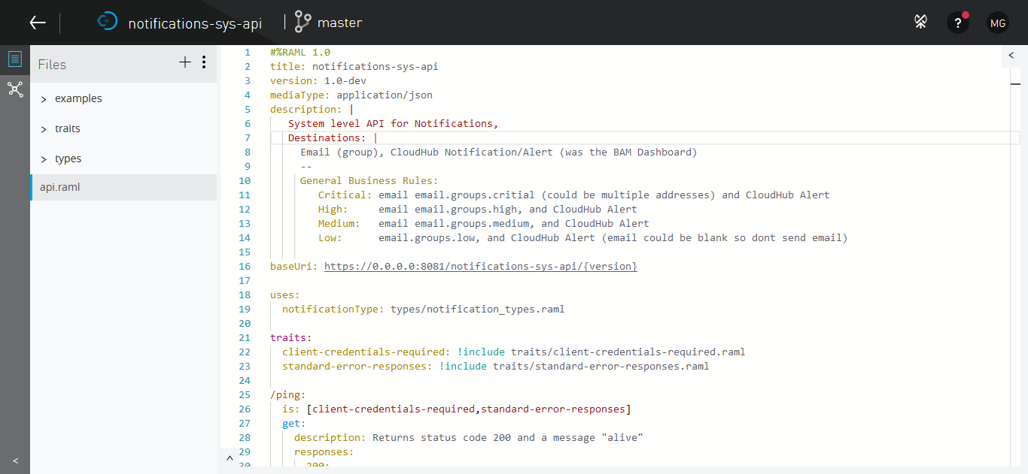
U
C
P
A
T
H
O
N
A
N
Y
P
O
I
N
T
P
L
A
T
F
O
R
M
Create API Specification
Mule Application …

Slide 23
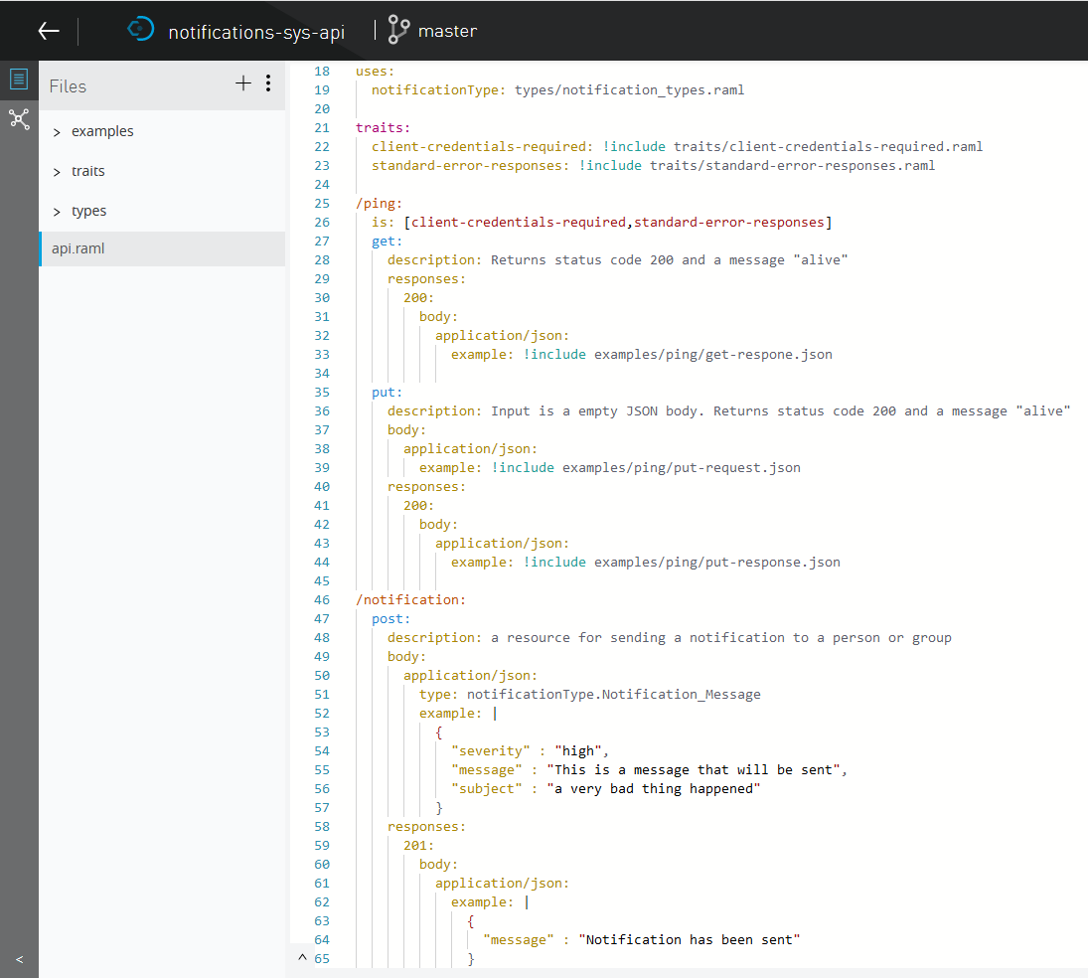
U
C
P
A
T
H
O
N
A
N
Y
P
O
I
N
T
P
L
A
T
F
O
R
M
Mule Application …

Slide 24
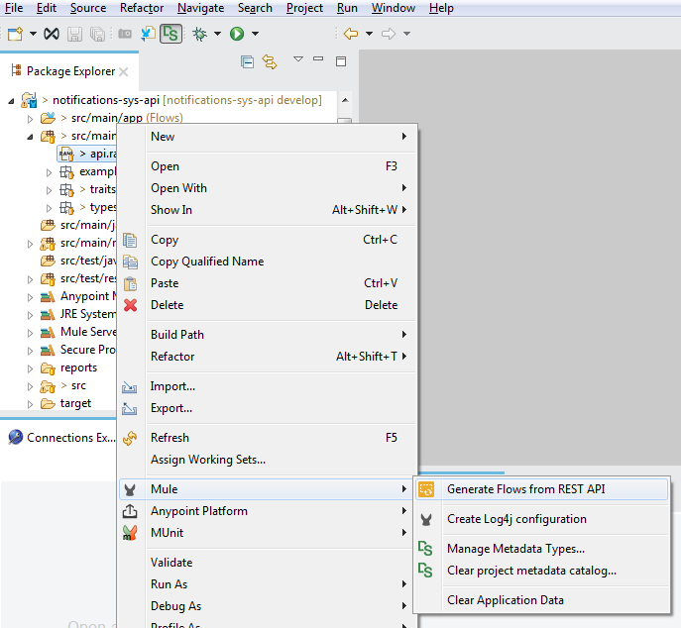
U
C
P
A
T
H
O
N
A
N
Y
P
O
I
N
T
P
L
A
T
F
O
R
M
Import project from Design Center to AnypointStudio and generate flows from the
RAML

Slide 25
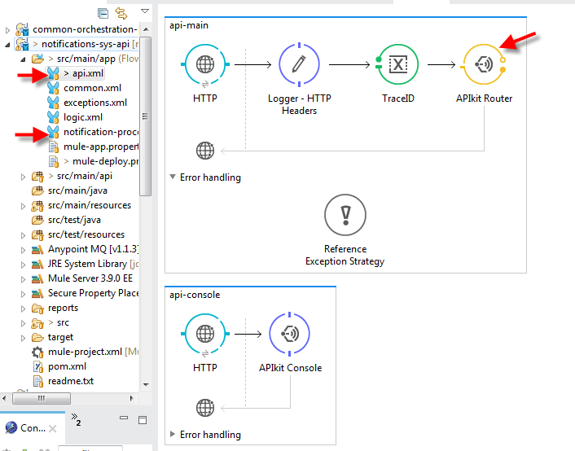
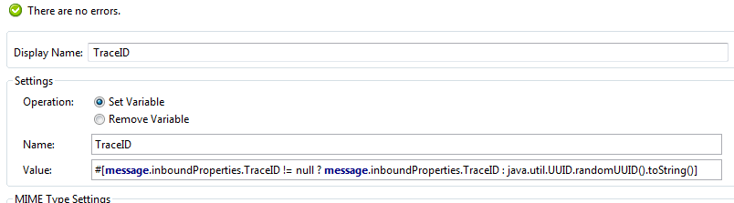
U
C
P
A
T
H
O
N
A
N
Y
P
O
I
N
T
P
L
A
T
F
O
R
M

Slide 26
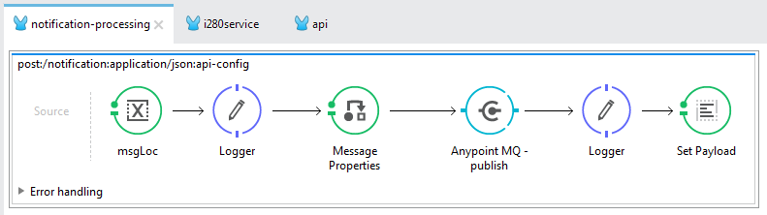
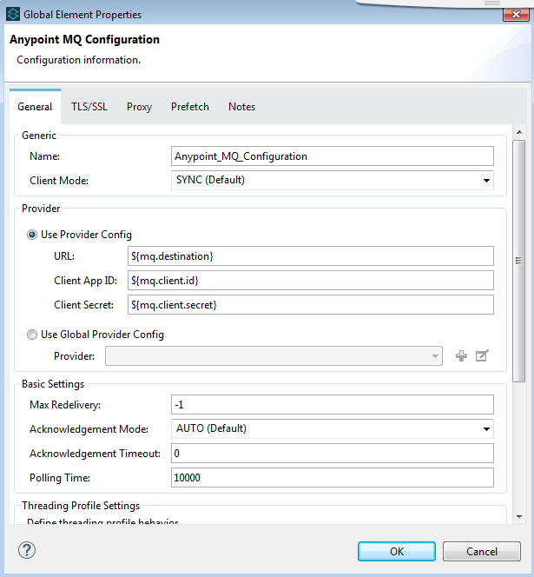
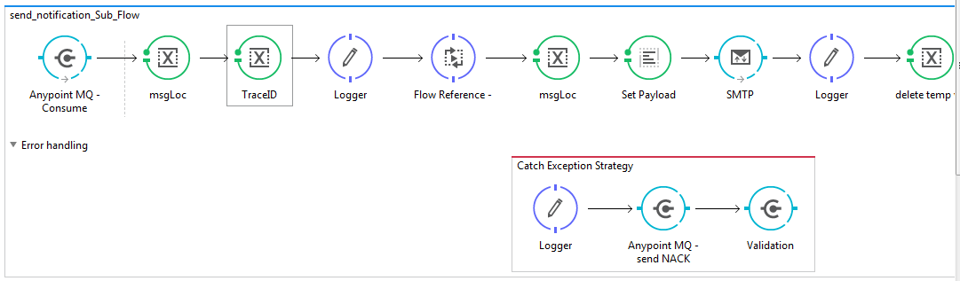
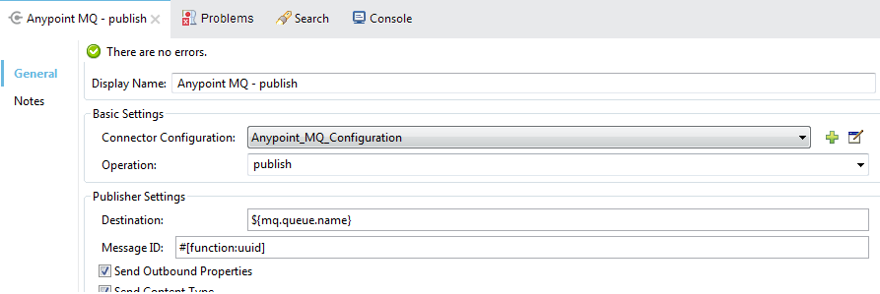
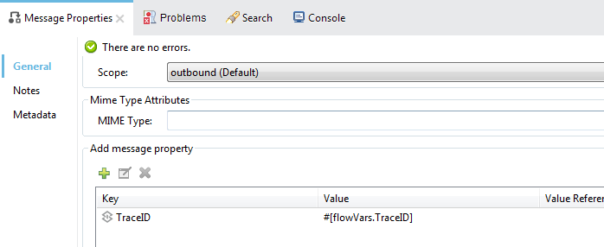
U
C
P
A
T
H
O
N
A
N
Y
P
O
I
N
T
P
L
A
T
F
O
R
M

Slide 27
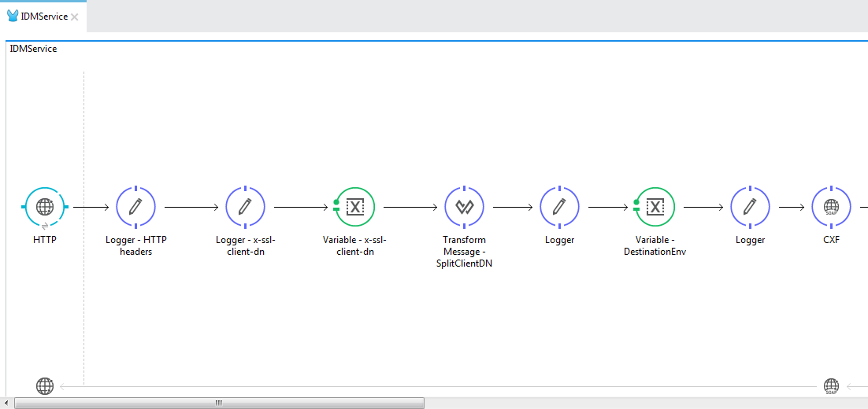
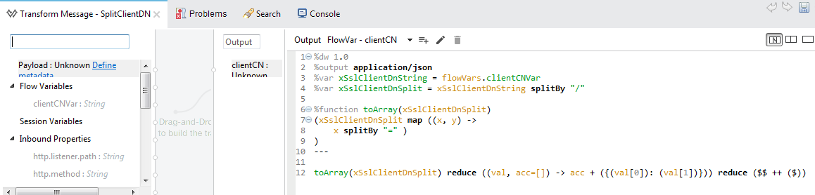
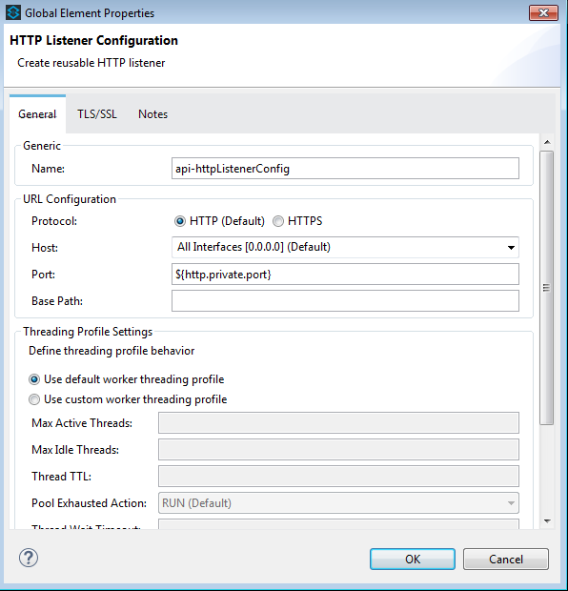
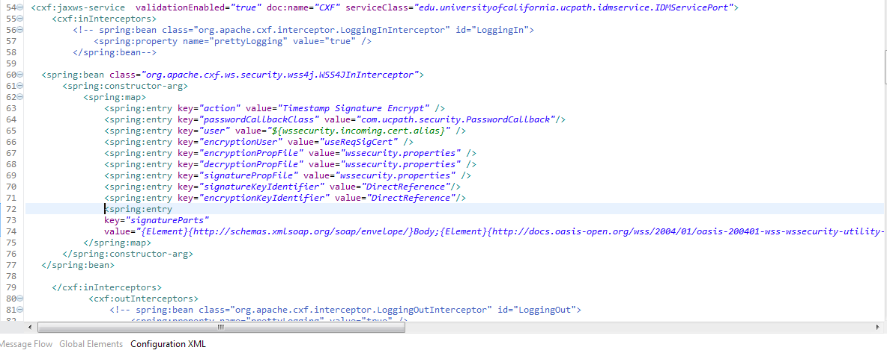
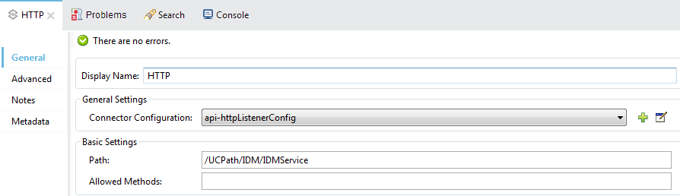
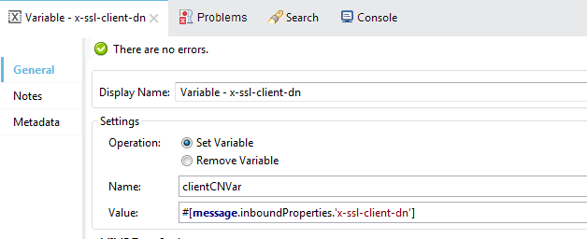
U
C
P
A
T
H
O
N
A
N
Y
P
O
I
N
T
P
L
A
T
F
O
R
M

Slide 28
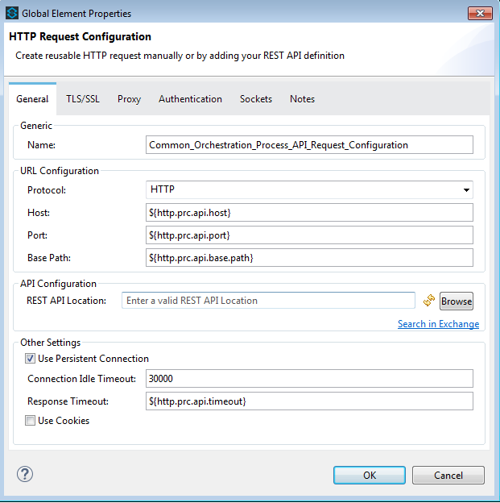
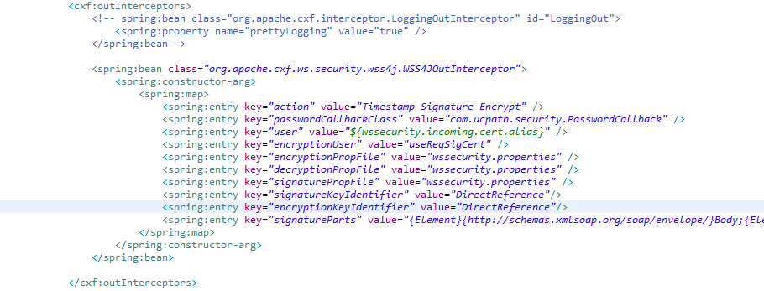
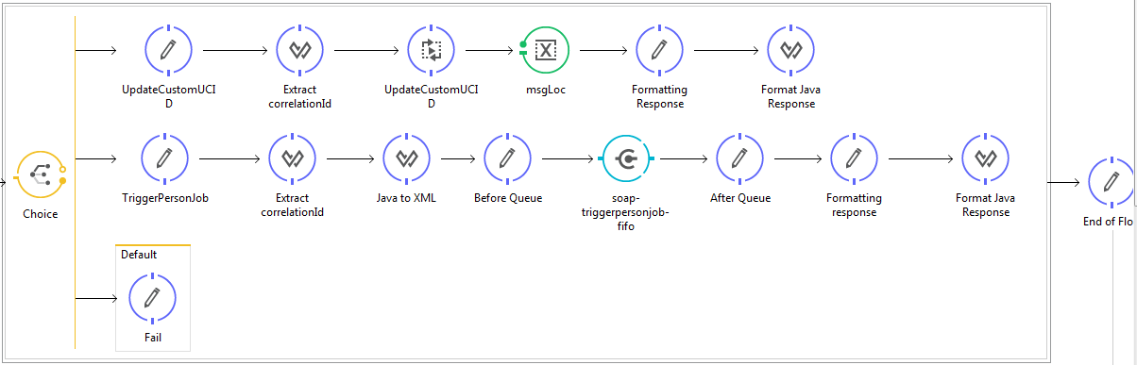
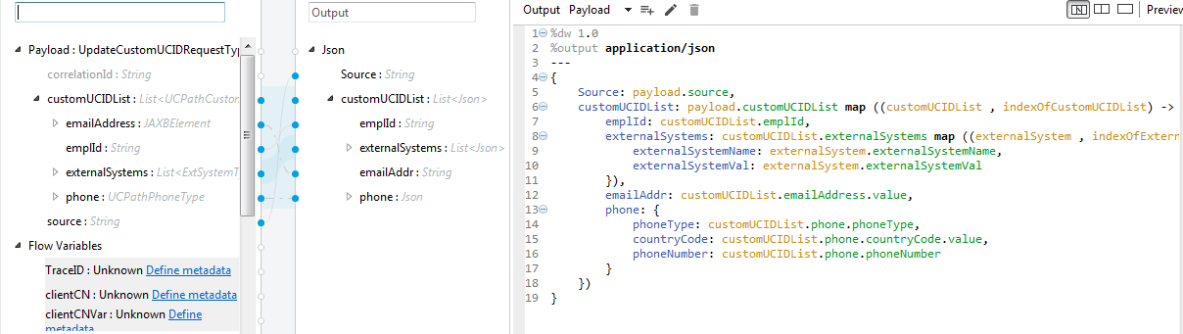
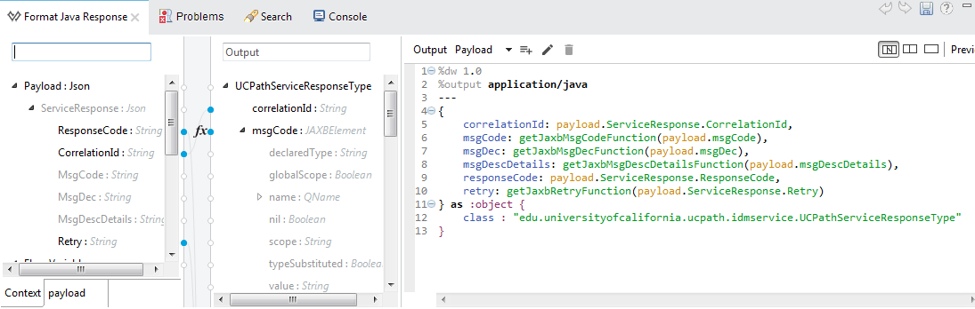
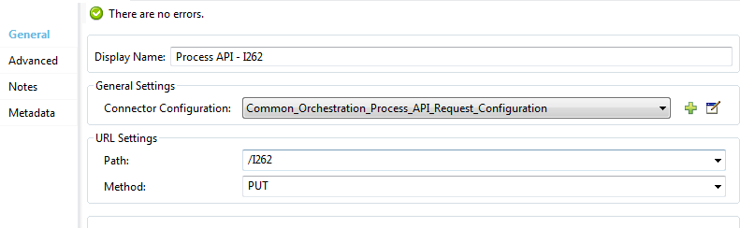
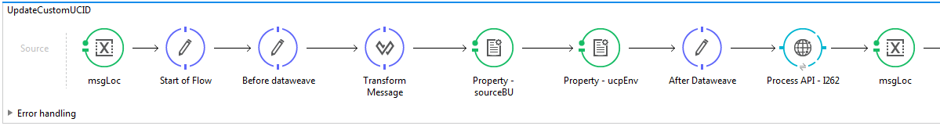
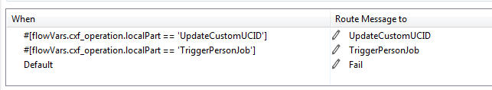

Slide 29
UCPath APIs
U
C
P
A
T
H
O
N
A
N
Y
P
O
I
N
T
P
L
A
T
F
O
R
M
System Layer (8)
ucpath-campus-sys-api
ucpath-glacier-sys-api
ucpath-peoplesoft-sys-api
ucpath-redwood-sys-api
ucpath-routing-sys-api
ucpath-sfdc-sys-api
ucpath-ucidm-sys-api
ucpath-notification-sys-api
Process Layer (1)
ucpath-common-orchestration-prc-api
Experience Layer (1)
ucpath-soap-exp-ap

Slide 30
Anypoint Platform – Experience So far
U
C
P
A
T
H
O
N
A
N
Y
P
O
I
N
T
P
L
A
T
F
O
R
M
Faster development – Migrated 17 SOA services to 10 APIs in 3 months
One IDE - design, develop, unit test, deploy
Less custom code – Out of the box connectors, components
Transformations made easy - Dataweave
2-way SSL, Msg Encr –CXF vs WSC
One log file
Very responsive customer support

Slide 31
Organization and Business Groups
U
C
P
A
T
H
O
N
A
N
Y
P
O
I
N
T
P
L
A
T
F
O
R
M
Organization
Our top level org is “UC Online”.
This is the parent Entity and holds all the parent assets
The administration of Business Groups is delegated to the Business group admins under the parent org
Business Groups
Business Groups are sub-entities created under the “UC Online” organization above
This can be a system wide project e.g. UCPath, or a Campus e.g. UCMerced, UCOP
Business group owner is the Business group admin
There are multiple Business groups within the “UC Online” organization above

Slide 32
Asset Sharing – API Exchange
U
C
P
A
T
H
O
N
A
N
Y
P
O
I
N
T
P
L
A
T
F
O
R
M
Exchange Private
For internal developers (viewer, contributor, or administrator access)
Assets could be limited to Business groups
Exchange Portal
Exchange admins only can share assets
Shared Externally with developers outside of their own organization
What can be shared ?
Mule XML example code, Template, Connector, APIs
Custom information assets.
Advantages
Model and reuse code and APIs
Easy access
Create a repository

Slide 33
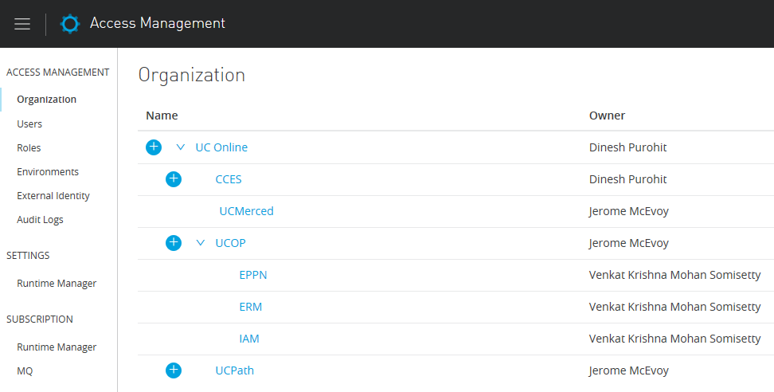
Organization and Business Groups
U
C
P
A
T
H
O
N
A
N
Y
P
O
I
N
T
P
L
A
T
F
O
R
M

Slide 34
UCOP - UCPath IDM Interfaces
U
C
P
A
T
H
O
N
A
N
Y
P
O
I
N
T
P
L
A
T
F
O
R
M
UCOP is Providing and Consuming Services to/from UCPath since past few years.
Current UCOP setup for services
The current interfaces are deployed on JBoss Application server.
Where we spend our time
Maintaining the Application server.
Regenerating the class for any WSDL changes.
This also involves deployment of new artifacts.
Software upgrades for Application server.
Maintaining Multiple environments(Dev, QA, UAT, Prod).
Coordination with Multiple team.

Slide 35
U
C
P
A
T
H
O
N
A
N
Y
P
O
I
N
T
P
L
A
T
F
O
R
M
Looking at the features MuleSoft is providing UCOP IAM has selected MuleSoft as the new integration platform.
Mule is the most lightweight integration platform available.
Mule integrates tightly with Spring.
Mule uses common tools that all Java developers are familiar with, like Maven, Eclipse, JUnit and Spring.
Mule IDE Anypoint Studio helps new developers get up to speed quickly with a graphical development environment.
Process large messages efficiently XML, JSON, flat files, binary and file attachments, streams, and Java objects.
Provides flexibility to deploy apps on cloud or on premise.
Upgrades managed by MuleSoft

Slide 36
UCOP IDM interface to CloudHub
U
C
P
A
T
H
O
N
A
N
Y
P
O
I
N
T
P
L
A
T
F
O
R
M
Maintaining and syncing the repository (i.e. WSDL, XSD and other changes) – Use of API Exchnage
To keep up with the market and technology evolution.
In Line with UCPath and other UC who are using MuleSoft.
Deploy same code base across multiple environments.
Reduces the dependency of Application servers plugins.

Slide 37
Anypoint Platform Support for SSO
U
C
P
A
T
H
O
N
A
N
Y
P
O
I
N
T
P
L
A
T
F
O
R
M
In Anypoint Platform, has a future to configure External Identity.
Anypoint Supports SAML2.0.
Anypoint Platform was tested configuring using Shibboleth.
Login to Anypoint and click on external identity to configure the IDP.

Slide 38
My Experience with MuleSoft
U
C
P
A
T
H
O
N
A
N
Y
P
O
I
N
T
P
L
A
T
F
O
R
M
When did I start thinking about MuleSoft.
How did I approach.
Training on MuleSoft.
Process/Plan to Migrate existing UCOP IDM interfaces.
Testing UCPath interfaces

Slide 39
Training
Easy to learn
Basic knowledge of XML, JSON, java/object oriented programming and integration technologies such as HTTP, JMS, JDBC, REST and SOAP.
Mulesoft provides free self study development fundamental course
Trainings we took:
Anypoint Platform Development: Fundamentals (Mule 3) - Online instructor-led
API Dev Advanced Training – 3-4 days – Online instructor led
Please check https://www.training.mulesoft.com for more information

Slide 40
CoE (Center of Excellence)
UCOP is going to form a new COE to provide consultation and professional services on the CloudHub platform.
Members:
Jerome McEvoy (jerome.mcevoy@ucop.edu)
Mukund Gidadhubli (mukund.gidadhubli@ucop.edu)
Rahul Morthala (rahul.morthala@ucop.edu)
Sushant Prasad (sushant.prasad@ucop.edu)
Krishna Mohan (krishna.mohan@ucop.edu)
Contact any member if your have questions

Slide 41
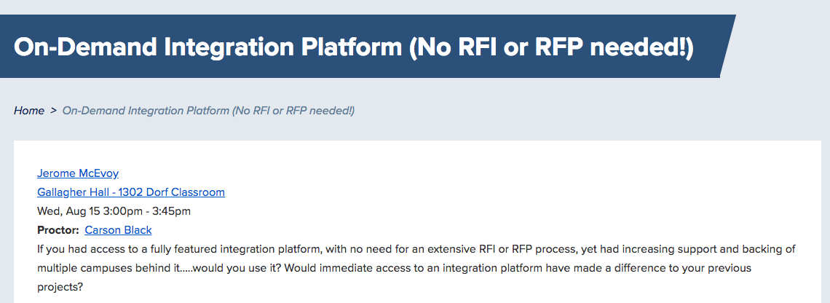
Learn more about accessing CloudHub (in 30 minutes)

Slide 42
Q & A

